Slide 1


What factors lead to Auto Insurance Fraud?
By Mike Stegmuller

Slide 2
Problem Statement
Insurance Fraud is a serious crime and should not be taken lightly. It is a problem for both the insurance companies and honest consumers. Identifying factors that lead to insurance fraud is important, so companies don’t have to pay our unnecessary compensation, but also keeps premiums down. Identifying what factors lead to fraud will not only help companies detect fraud better, but will also, prevent people from committing fraud and going to jail.

Slide 3
Data
Car accident data from IL, IN, and OH showing various accident details such as: incident severity, gender, hobbies and occupation.
Dataset and Information https://data.mendeley.com/datasets/992mh7dk9y/2

Slide 4
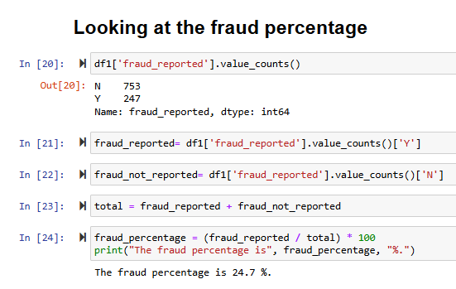
Data Wrangling
Cleaning the CSV
Removed NaN’s
Looking for percentage of Fraud

Slide 5
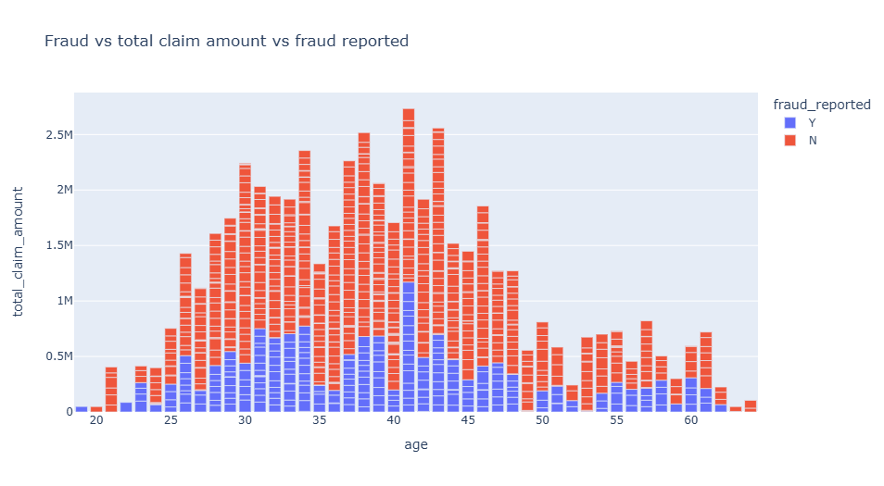
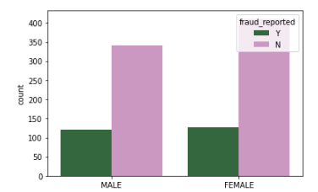
Insured Key Features

Slide 6
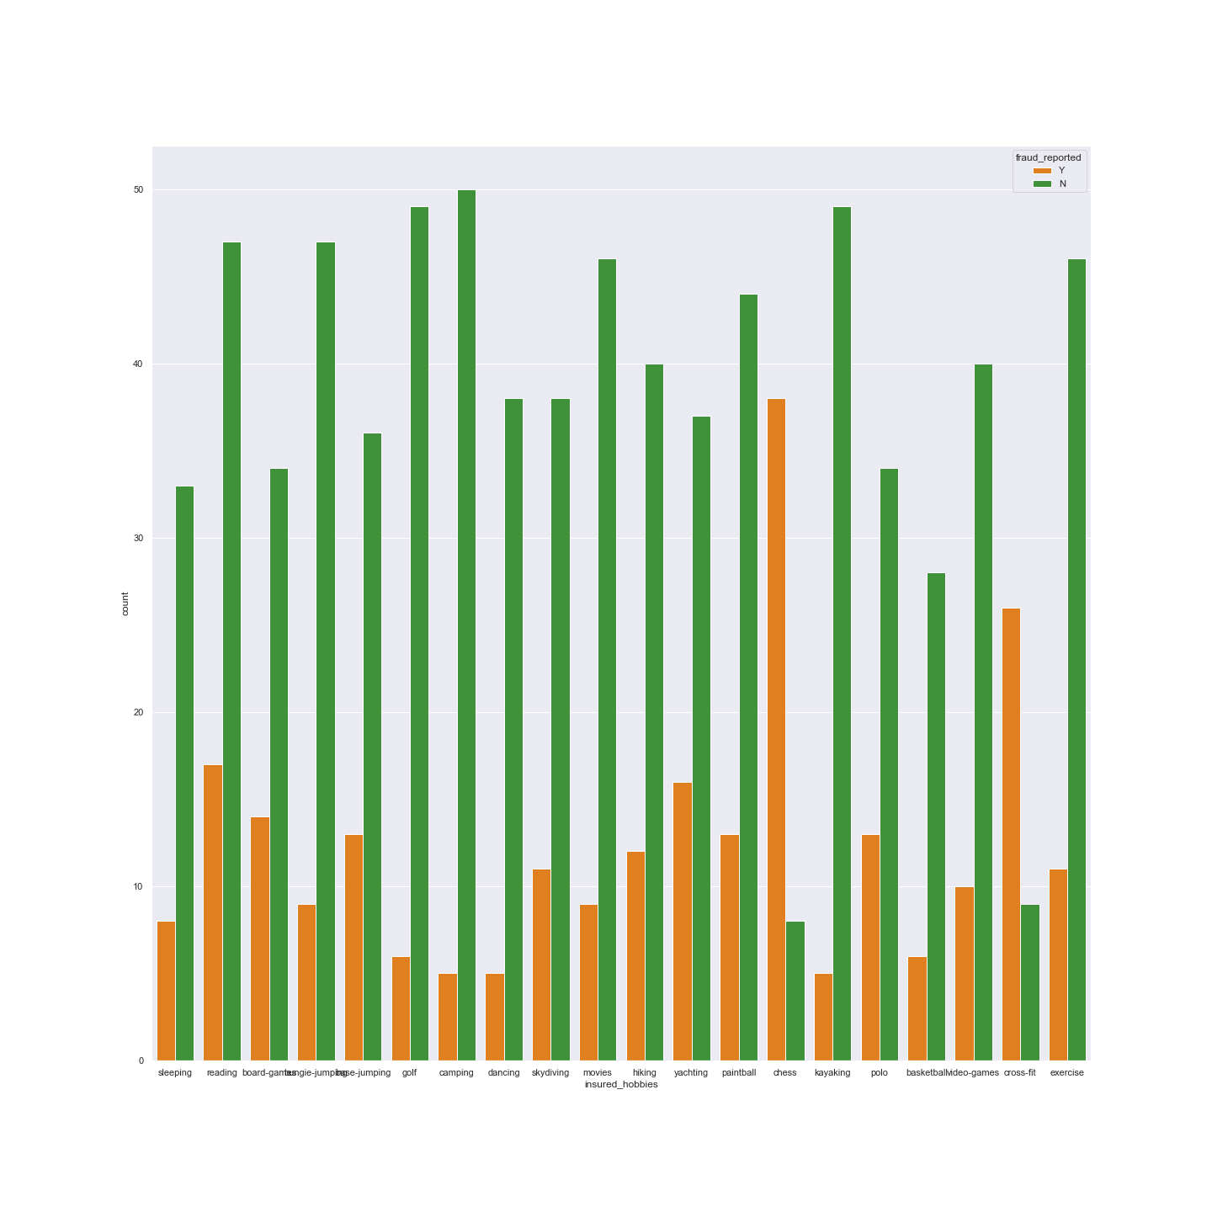
Insured Hobbies

Slide 7
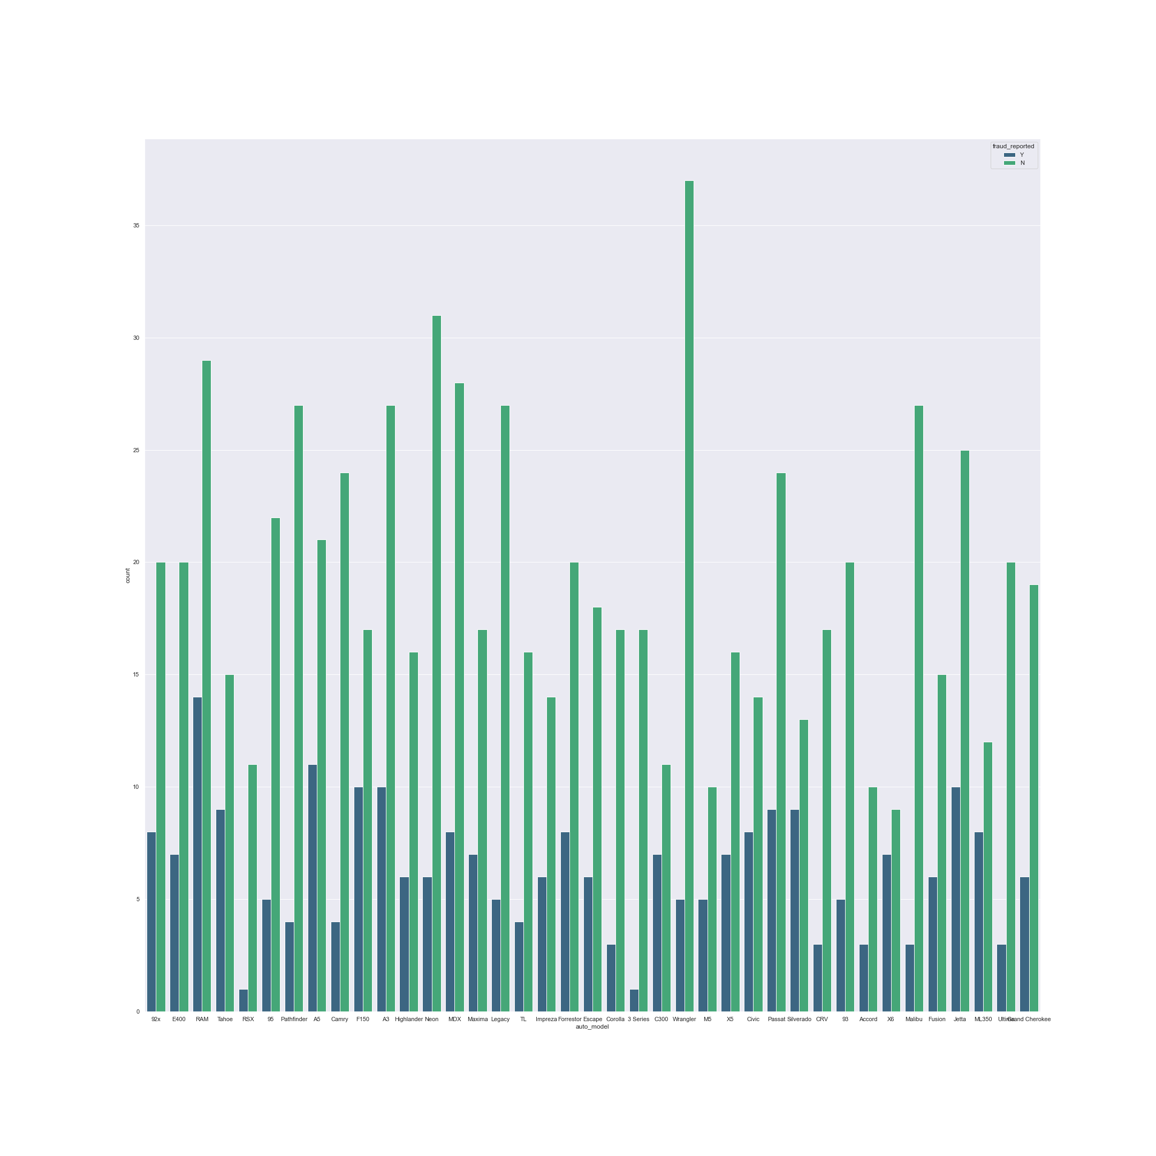
Insured Car Model

Slide 8
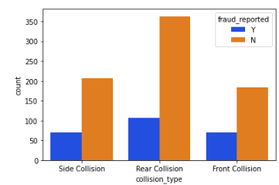
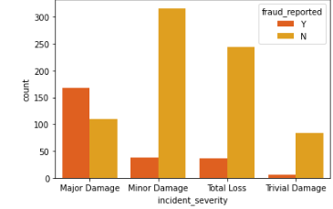
Accident Features

Slide 9
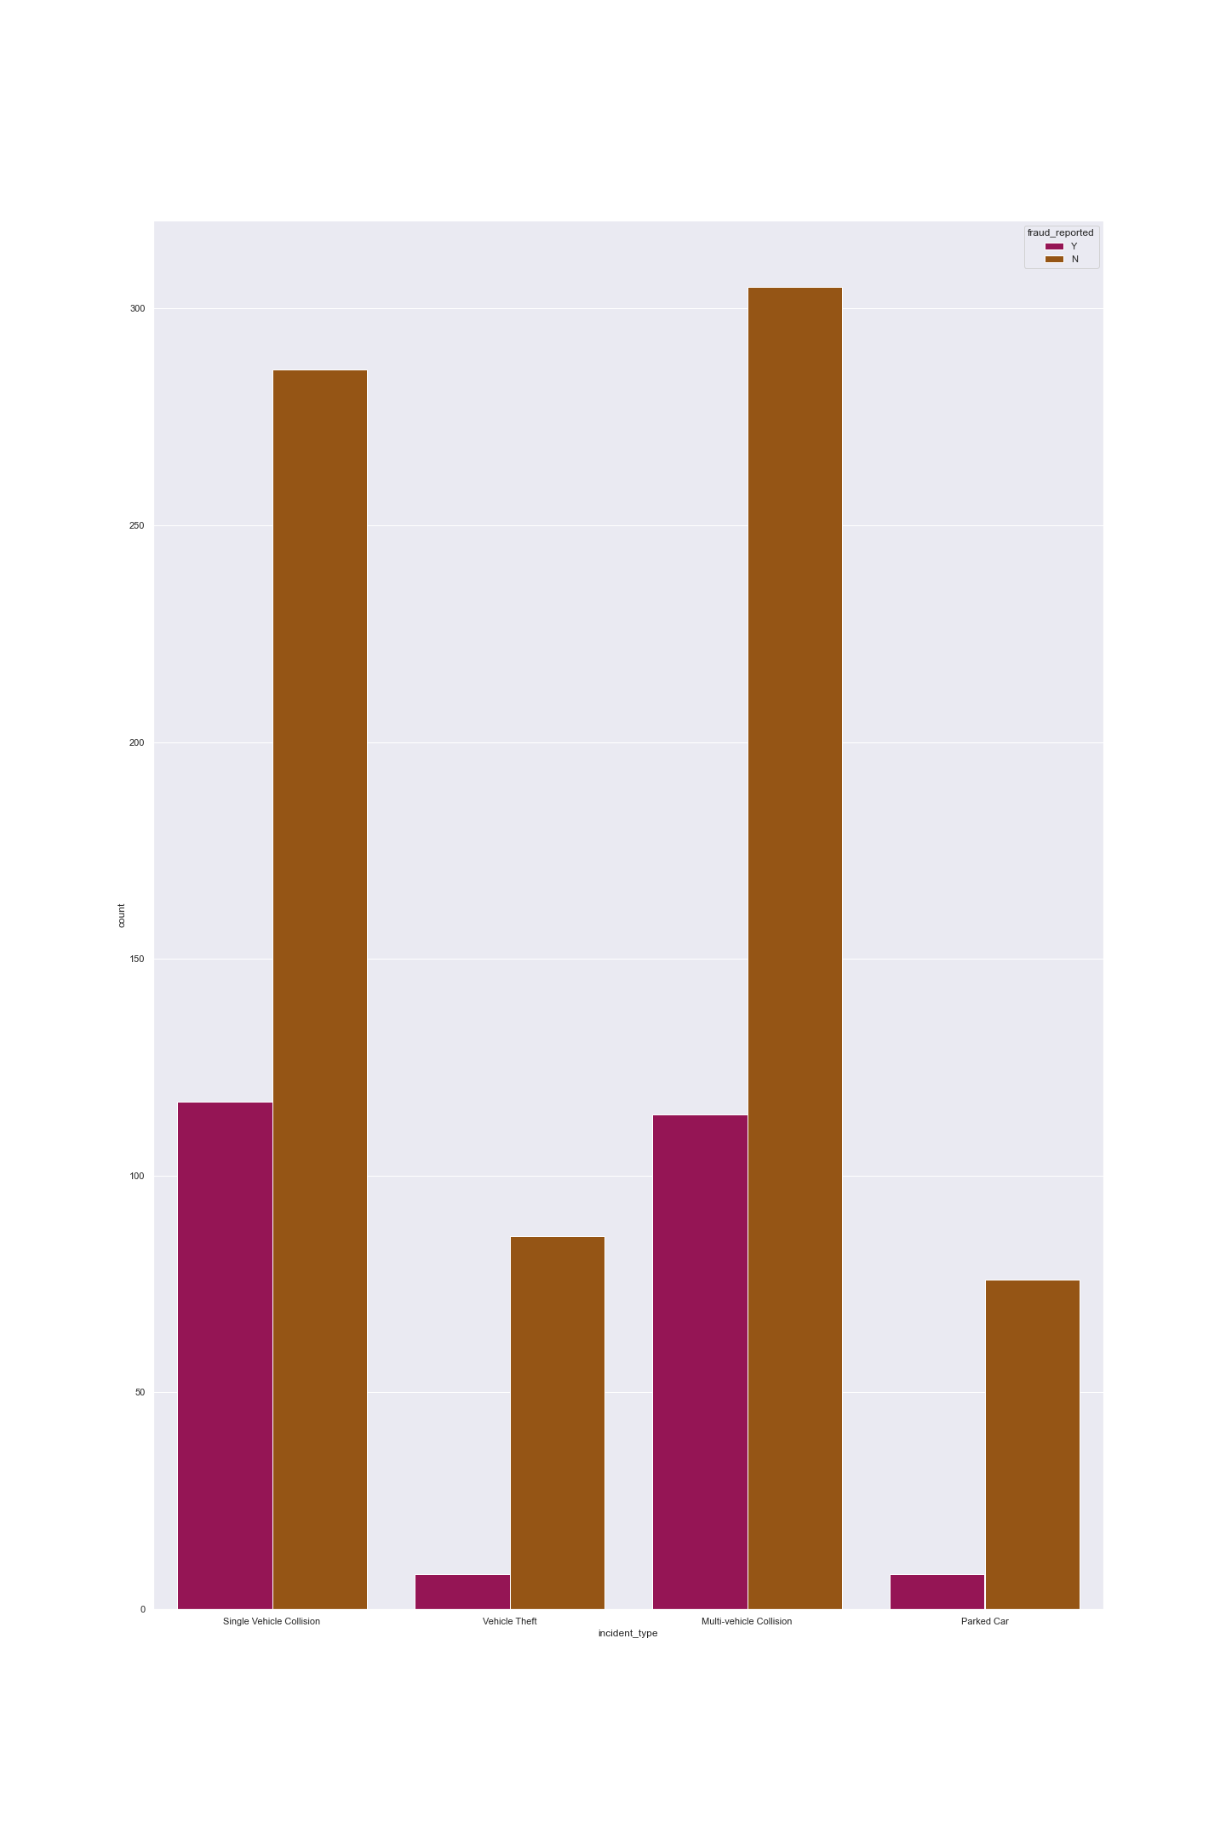
Incident Type
Single Vehicle Collision
Vehicle Theft
Multi Vehicle Collision
Parked Car

Slide 10
Modeling
Loaded clean, imbalanced dataset, separated categorical and numerical data, applied dummy features to categorical data
Set X to features y to fraud reported
Test, train, split data and use standard scaler
Machine Learning: Decision Tree regressor, Ada Boost Classifier, Gradient boost classifier
Balanced Dataset using SMOTE to compare unbalanced and balanced results

Slide 11

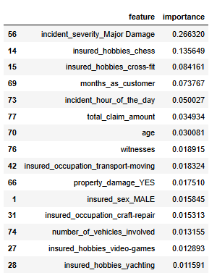
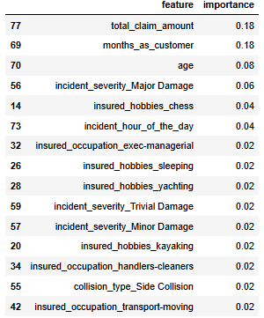
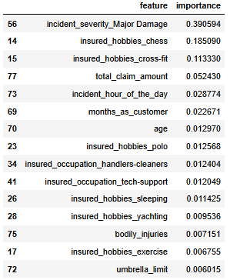
Results
Decision Tree Regressor
Ada Boosting
Gradient Boosting

Slide 12

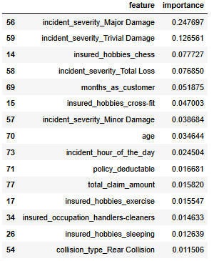
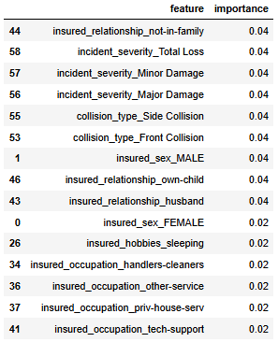
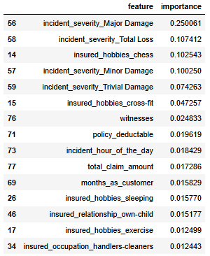
Results w/ SMOTE Balanced Data
Decision Tree Regressor
Ada Boosting
Gradient Boosting

Slide 13
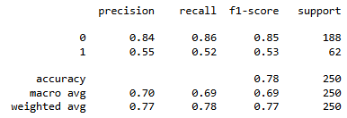
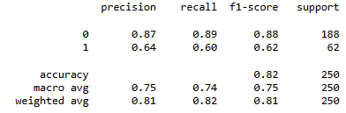
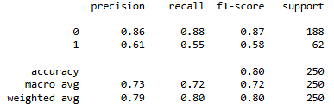
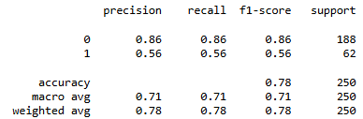
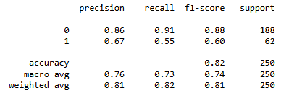
Classification report and accuracy score
Decision Tree
Gradient Boosting
Ada Boosting

Slide 14
Analysis
Gradient Boosting Classifier produced best results
Incident severity was the most important feature
Hobbies
Witnesses
Deductible

Slide 15
Recommendations
Question insureds who commit fraud the reasons why they decided to commit fraud to see what other factors could be used.
Police involvement
Family issues
Salary
Give insureds information so they know insurance companies know factors that lead to fraud to dissuade people from committing fraud

Slide 16
Practical considerations and Future work
Get more information from other states
01
Get information on where fraud is happening
02
Create a model showing where there are high rates of fraud

Slide 17

Questions?

